Slide 1
Final Exam Review

Slide 2
Question: #1
What is the smallest unit that can carry on all the functions of life called?

Slide 3
Question #2
What is the protein disk that attaches the two chromatid arms to each other in a chromosome called?

Slide 4
Question #3
How many pairs of chromosomes are in the human body?

Slide 5
Question #4
How many sex chromosomes are in the human body?

Slide 6
Question #5
How many autosomes are in the human body?

Slide 7
Question #6
How many chromosomes are in a human egg cell?

Slide 8
Question #7
What is the process by which bacteria reproduce?

Slide 9
Question # 8
What stage of the cell cycle occupies most of the cell’s life?

Slide 10
Question #9
Which phase of mitosis are the chromosomes lined up at the equator of the cell?

Slide 11
Question # 10
What divides in the process of mitosis?

Slide 12
Question # 11
When crossing-over takes place, what do chromosomes exchange?

Slide 13
Question #12
Who is the “father” of genetics?
(last name only is fine)

Slide 14
Question # 13
What is the passing of traits from parents to offspring?

Slide 15
Question #14
What is a genetic trait that appears in every generation of offspring called?

Slide 16
Question #15
What is the phenotype of an organism?

Slide 17
Question # 16
Who are the scientists credited with establishing the structure of DNA?

Slide 18
Question #17
What are the base pairing rules in DNA?

Slide 19
Question # 18
What is the function of tRNA?

Slide 20
Question #19
What is a nucleotide that has 3 letters in mRNA and specifies a particular amino acid called?

Slide 21
Question #20
What are the molecules called that each organism has that encodes its unique characteristics ?

Slide 22
Question #21
What is the primary function of DNA?

Slide 23
Question #22
What are the 3 components of a nucleotide?

Slide 24
Question #23
What group of islands did Darwin travel to and form most of his ideas for his theory?

Slide 25
Question #24
What is the process by which a population becomes better suited to its environment?

Slide 26
Question #25
What is the term used to describe organisms that acquired traits better suited to their environment enabling them to better survive and reproduce?

Slide 27
Question #26
What is the science of classifying living things called?

Slide 28
Question #27
What scientist developed the system of classifying organisms by assigning them a genus and species name?

Slide 29
Question #28
What is a group of organisms of different species living together in a particular place called?

Slide 30
Question #29
What is the specific physical location in which a given species lives called?

Slide 31
Question #30
How much energy is received from one trophic level to the next higher energy level?

Slide 32
Question #31
What are major ecosystems that occur over wide areas of land called?

Slide 33
Question #32
What biome receives less than 10 inches of rain a year and is extremely dry?

Slide 34
Question #33
What type of relationship is between flowering plants and the bees that pollinate them?

Slide 35
Question #34
What is an organism called that can make its own food?

Slide 36
Question #35
What is the most abundant type of species?

Slide 37
Question #36
When a new community is changed over time to a new community is called what?

Slide 38
Question #37
Which biome is characterized by evergreen trees that are adapted to long winters, short summers and nutrient POOR soil?

Slide 39
Question #38
What are the 3 reactants in photosynthesis?

Slide 40
Question #39
What is an example of a density independent factor?

Slide 41
Question #40
What process does an autotroph use chemical energy to make its own food?

Slide 42
Question #41
What is the study of the interaction of living organisms with each other and with their physical environment?

Slide 43
Question #42
List the classification order from greatest to smallest. (There are 7)

Slide 44
Question #43
Which organism is the oldest on the phylogenetic tree?

Slide 45
Question #44
In which language are scientific names written?

Slide 46
Question #45
What is the nitrogen base NOT found in DNA but only in RNA?

Slide 47
Question #46
What part of a DNA molecule is made up by a sugar, a phosphate group and a nitrogen base?

Slide 48
Question #47
Destroying the OZONE layer will allow more UV radiation to hit earth and increase the rate of what type of cancer?

Slide 49
Question #48
What phase of the cell cycle is this?

Slide 50
Question #49
What phase of the cell cycle is this?

Slide 51
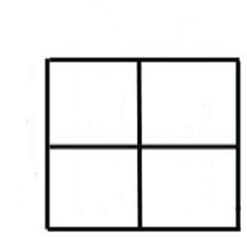
Question #50
What is
the
genotype
that
would be
in box #4?
T=Tall
T
T
t
1
2
3
4
t

Slide 52
Question #51
What is
the
phenotype
that
would be
in box #2?
T=Tall
T
T
t
1
2
3
4
t

Slide 53
Question #52
What is the primary producer in a grassland ecosystem?

Slide 54
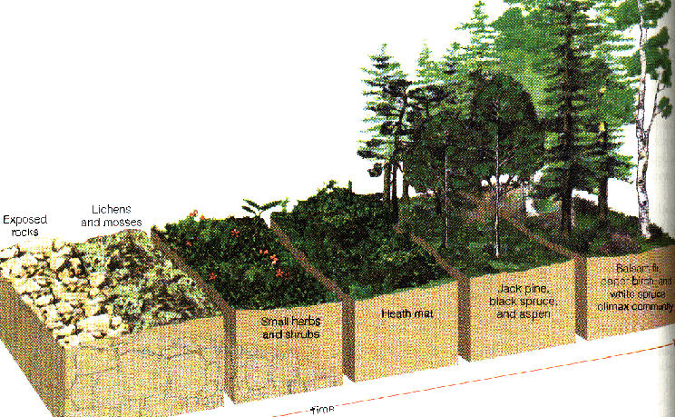
Question #53
What is the transformation over time shown in the diagram is known as?

Slide 55
Pass one more time… and STOP~

