Slide 1
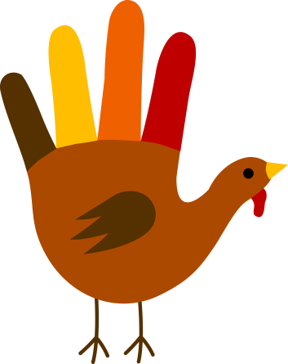
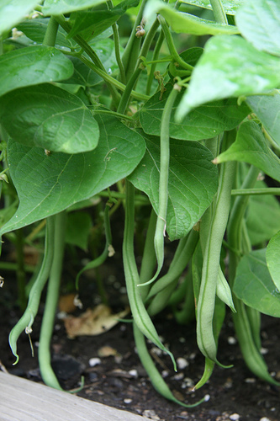
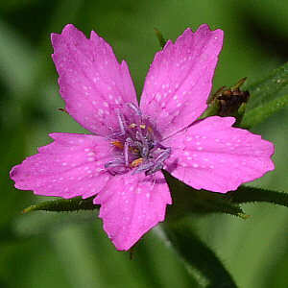
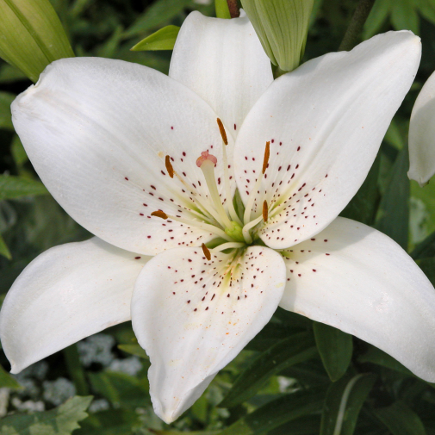
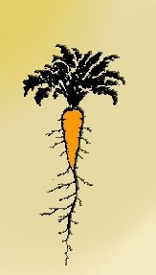
Bell ringer November 16, 2015
Identify all of the following pictures as either a monocot or dicot.
1
2
3
4
5
6

Slide 2
Bell ringer November 17, 2015
Name the three parts of the pistil (female reproductive structure).
Name the two parts of the stamen (male reproductive structure).
Brightly colored flowers are easily going to attract pollinators. What are some other ways that flowers might attract pollinators if they are not brightly colored?

Slide 3
Bell ringer November 18, 2015
Explain why both autotrophs and heterotrophs depend on photosynthesis to obtain the energy they need for life processes. Include in your answer where energy ultimately begins.
(Please answer with 2-3 complete sentences.) You do not have to write down the prompt.

Slide 4
Bell ringer November 19, 2015
In your own words, describe the ATP and ADP cycle.
Then in your own words, create an analogy to help you remember the difference between ATP and ADP.

Slide 5
Bell ringer November 20, 2015
Based on the cycle of photosynthesis and cellular respiration, one can say that the ultimate original source of energy for all living things on Earth is
Water
Glucose
The sun
Carbon dioxide
ADP is changed to ATP because
ATP helps produce glucose
ADP does not have enough energy to meet the needs of living cells
ADP has three phosphates
ADP has more available energy
Chlorophyll is green because
It transmits light and causes an optical illusion
It reflects green wavelengths of light
It absorbs blue and yellow wavelengths, which make green
It absorbs green wavelengths of light

Slide 6
Bell ringer November 30, 2015
A student conducts an experiment by collecting the gas given off by a green plant in bright sunlight at room temperature. The gas being collected is probably ____________________.
ATP
Water Vapor
Carbon Dioxide
Oxygen
In photosynthesis, how many molecules of carbon dioxide are used to make 1 molecule of glucose?
1
2
6
12

Slide 7
Bell ringer December 3, 2015
Which process generates most of the ATP produced during cellular respiration?
Electron Transport Chain
Fermentation
Glycolysis
Krebs Cycle
The aerobic and anaerobic pathways of cellular respiration require which products of glycolysis?
NADH and ATP
Pyruvate and ATP
Pyruvate and NADH
ATP, pyruvate, and NADH
While investigating yeast respiration, a researcher detects ethyl alcohol in the yeast culture. Which molecules does the yeast culture also contain?
Lactic Acid and ATP
Oxygen and lactic acid
Carbon dioxide and ATP
Oxygen and carbon dioxide

