Slide 1
Bell ringer September 22, 2015
(write down the complete answer for each question)
Which solution has the greatest concentration of hydroxide ions (OH-)?
Urine (pH 6.0)
Rainwater (pH 5.5)
Tomato Juice (pH 4.0)
Gastric Juice (pH 2.0)
How do catalysts speed up chemical reactions?
By reducing activation energy
By reducing energy produced by the reaction
By increasing activation energy
By increasing energy produced by the reaction

Slide 2
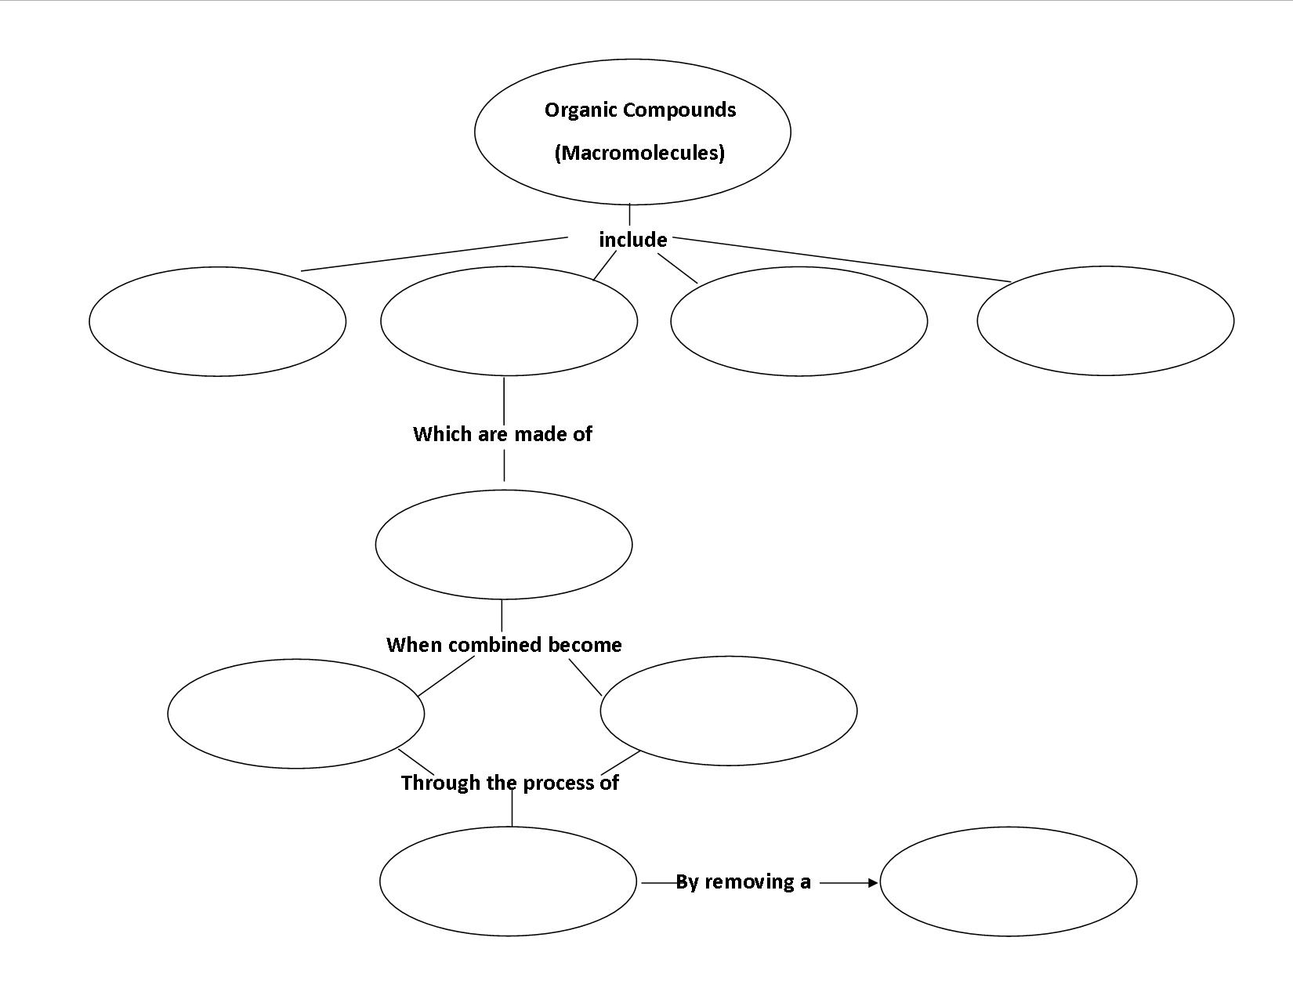
Bell ringer (Advanced) September 23, 2015
Use the following terms and phrases to complete the concept map below. (carbohydrates, lipids, monosaccharides, nucleic acids, water, polysaccharides, disaccharides, proteins, dehydration synthesis)

Slide 3
Bell ringer (General) September 23, 2015
Write down each word and its meaning as a prefix.
Mono-
Di-
Poly-
Bio-
Hydro-
Synthesis-
Lysis-

Slide 4
Bell ringer September 25, 2015
A substitute for fat was approved by the FDA in 1996 for use in certain foods, called Olestra. The benefit of eating foods that contain this fat substitute is that it passes through the body without being digested or absorbed. Thus, foods made with this fat substitute can effectively reduce usable energy intake. In some people, the fat substitute causes stomach cramps, diarrhea, and the loss of fat-soluble vitamins and beta-carotene.
Determine if the benefits out weigh the possible side effects. (Only write down your answer)

Slide 5
Bell ringer September 28, 2015
A substitute for fat was approved by the FDA in 1996 for use in certain foods, called Olestra. The benefit of eating foods that contain this fat substitute is that it passes through the body without being digested or absorbed. Thus, foods made with this fat substitute can effectively reduce usable energy intake. In some people, the fat substitute causes stomach cramps, diarrhea, and the loss of fat-soluble vitamins and beta-carotene.
Determine if the benefits out weigh the possible side effects. (Only write down your answer)

Slide 6
Bell ringer September 29, 2015
Which formula represents an organic molecule?
2. What key factor distinguishes organic compounds from inorganic compounds?
Organic compounds contain carbon
Organic compounds contain hydrogen
Organic compounds provide energy for cells
Organic compounds are the building blocks of cells

Slide 7
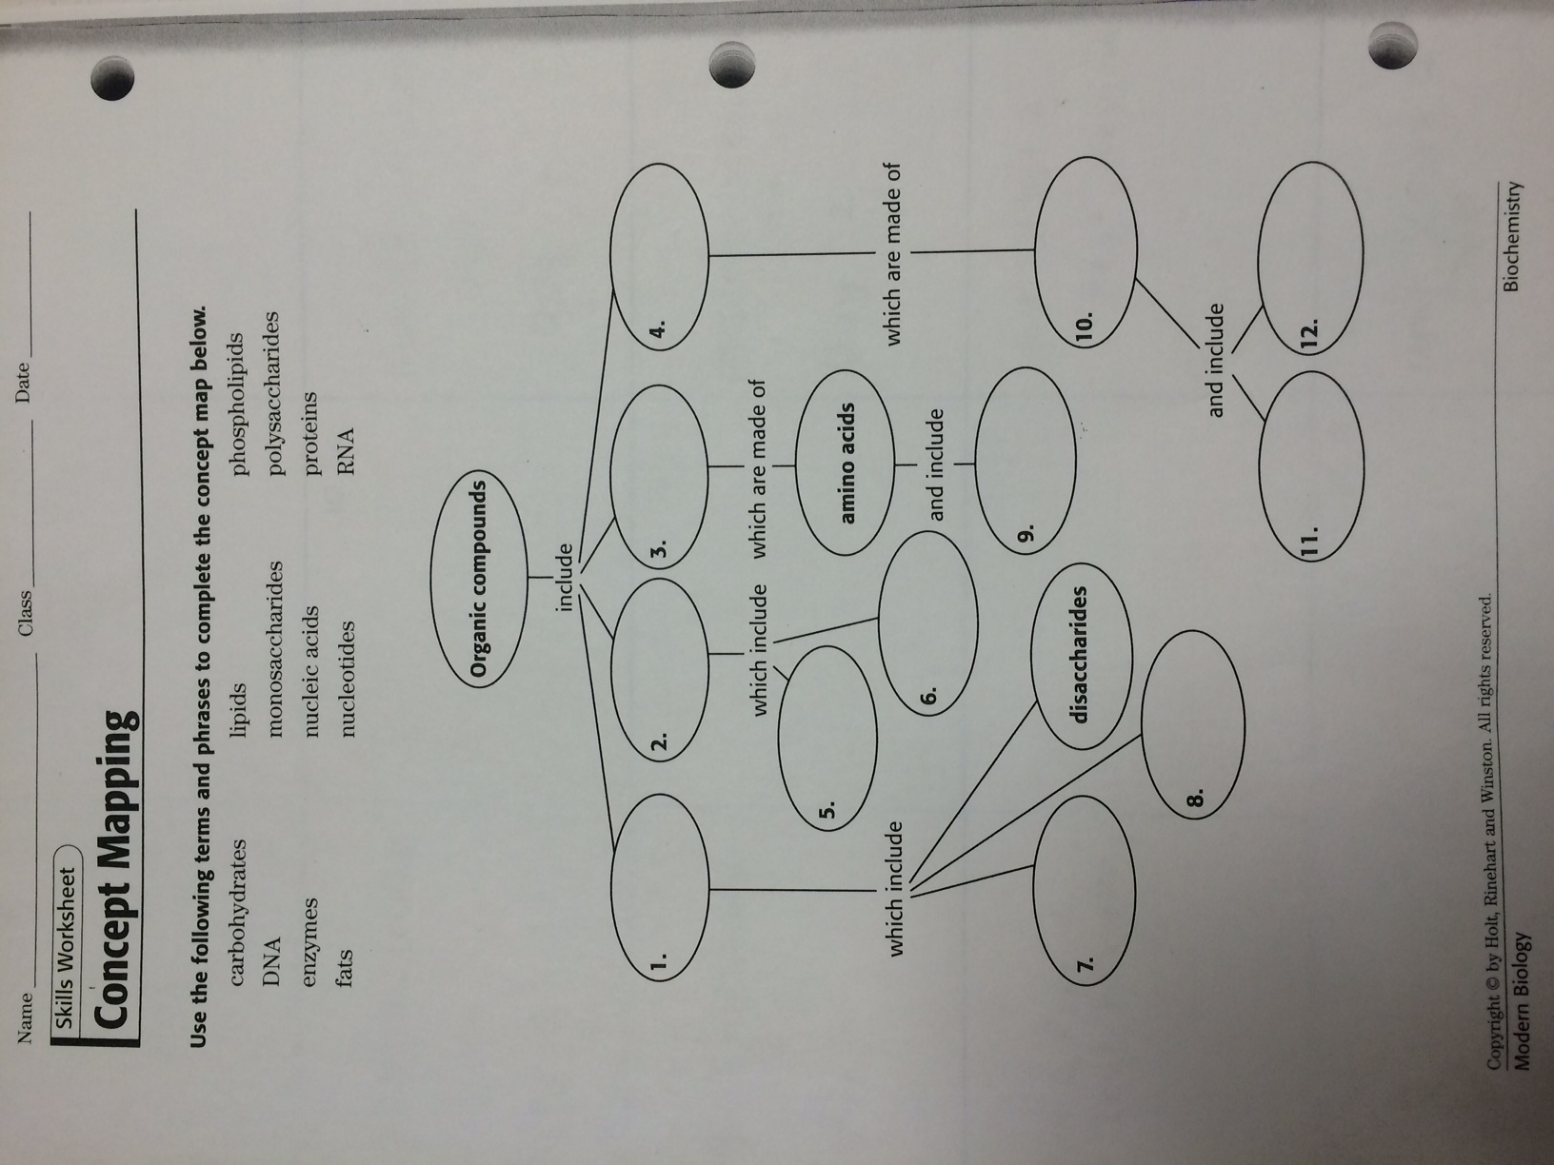
Bell ringer October 5, 2015

